Slide 1

Discipleship
Notes:
Today I want to talk to you a bit about Discipleship.
I believe most of our churches use the term discipleship, but they don’t actually do it.
The reason they don’t do it is because it has not been modeled to them. Their training has come mostly from Seminary and this
is the classical teaching method similar to what we all receive going to school.
The definition of discipleship I am going to be talking about is one man meeting with another man. 1 to 1.

Slide 2


- Matthew 9:37
Then He said to His disciples,
The Harvest is plentiful, but the workers are few. Therefore beseech the Lord of the Harvest to send out workers into His harvest.
Notes:
My prayer for today is that as a result of talking about Discipleship a few men in this room would have interest in getting involved in discipleship having never been involved with it before. I am hoping there will be more men working in the harvest after this weekend.

Slide 3
What is Discipleship?
Definition of the word Disciple: A name given to the followers of any teacher.
John the Baptist had disciples. (Matthew 11:2)
Notes:
Many influential leaders good and bad have had disciples.
John the Baptist
David Koresh
Charles Manson
A serious follower of a teacher. Jesus gave His life to people. Matthew 20:28 “just as the Son of Man did not come to be served, but to serve, and to give His life a ransom for many”.
The disciple takes on the likeness of the teacher.
My working definition of Discipleship:
Any man that is a follower of Jesus that takes seriously becoming involved in the lives of other men to reproduce in their lives what God has done in his life through God’s word and the work of the Holy Spirit.

Slide 4
Sheep Vs. Disciple
Characteristics of a Sheep
Jesus Calls His sheep and they respond and follow. (John 10:3)
Jesus laid His life down for His sheep. (John 10:11)
Sheep are both Jew and Gentile believers. (John 10:14-16)
Jesus leads His sheep from death to life. (John 10:26-28)
None of these are conditional statements. Jesus does this for all believers.
Notes:
Let’s talk about the differences between being a sheep and a disciple. Jesus talks about both quite a bit in the gospels.
Jesus’ sheep encompass all of His followers. If you are a Christian, you are one of Jesus’ sheep.
Have reader read each passage. (Rob or Greg)
There is nothing we must do to be a sheep of Jesus. He initiates the relationship and we follow.
There are great benefits to being one of Jesus’ sheep.
Joy, Peace, Eternal life.

Slide 5
Sheep Vs. Disciple
Characteristics of a Disciple
There is a cost to discipleship. Many things must be given up or go down the list of priorities so we can focus on being a disciple. (Luke 14:26)
Self-Denial is an important aspect of Discipleship. (Luke 14:27)
We must see our possessions as Christ’s not ours. (Luke 14:33)
We must be men of the word. (John 8:31)
You need to love people. (John 13:35)
Notes:
Luke 14:26- Jesus must come before all relationships. It’s no accident Jesus talks about family. Many times I hear men give an excuse that they need to disciple their families and they don’t have time to disciple anyone else. While I agree family comes first, many times it is an excuse to avoid doing it. If you don’t implement it early in your life, you most likely won’t do it in your 40’s and 50’s when your kids are out of the home. Disciplines are much easier to implement when we are young like exercise and a daily quiet time with God.
Luke 14:27- Many times we have to vote against ourselves to be involved in discipleship. a promotion at work, late night calls, not as many golf rounds or other hobbies will have to suffer to minister to men.
(Craig skipping golf at premier club with Jeremy Camp.)
Luke 14:33 – (Buddies income suffered but he still made paying for guys lunches a priority.)
John 8:31 – We need to put God’s word in us so we can give it away. (We will focus on that some more later.)
John 13:35 – (Coly coming to Christ at the Guy’s Thing.)
All Christians are sheep, but not all sheep are disciples.
To become a sheep of Jesus the cost was His life. To become a Disciple of Jesus the cost is your life.

Slide 6
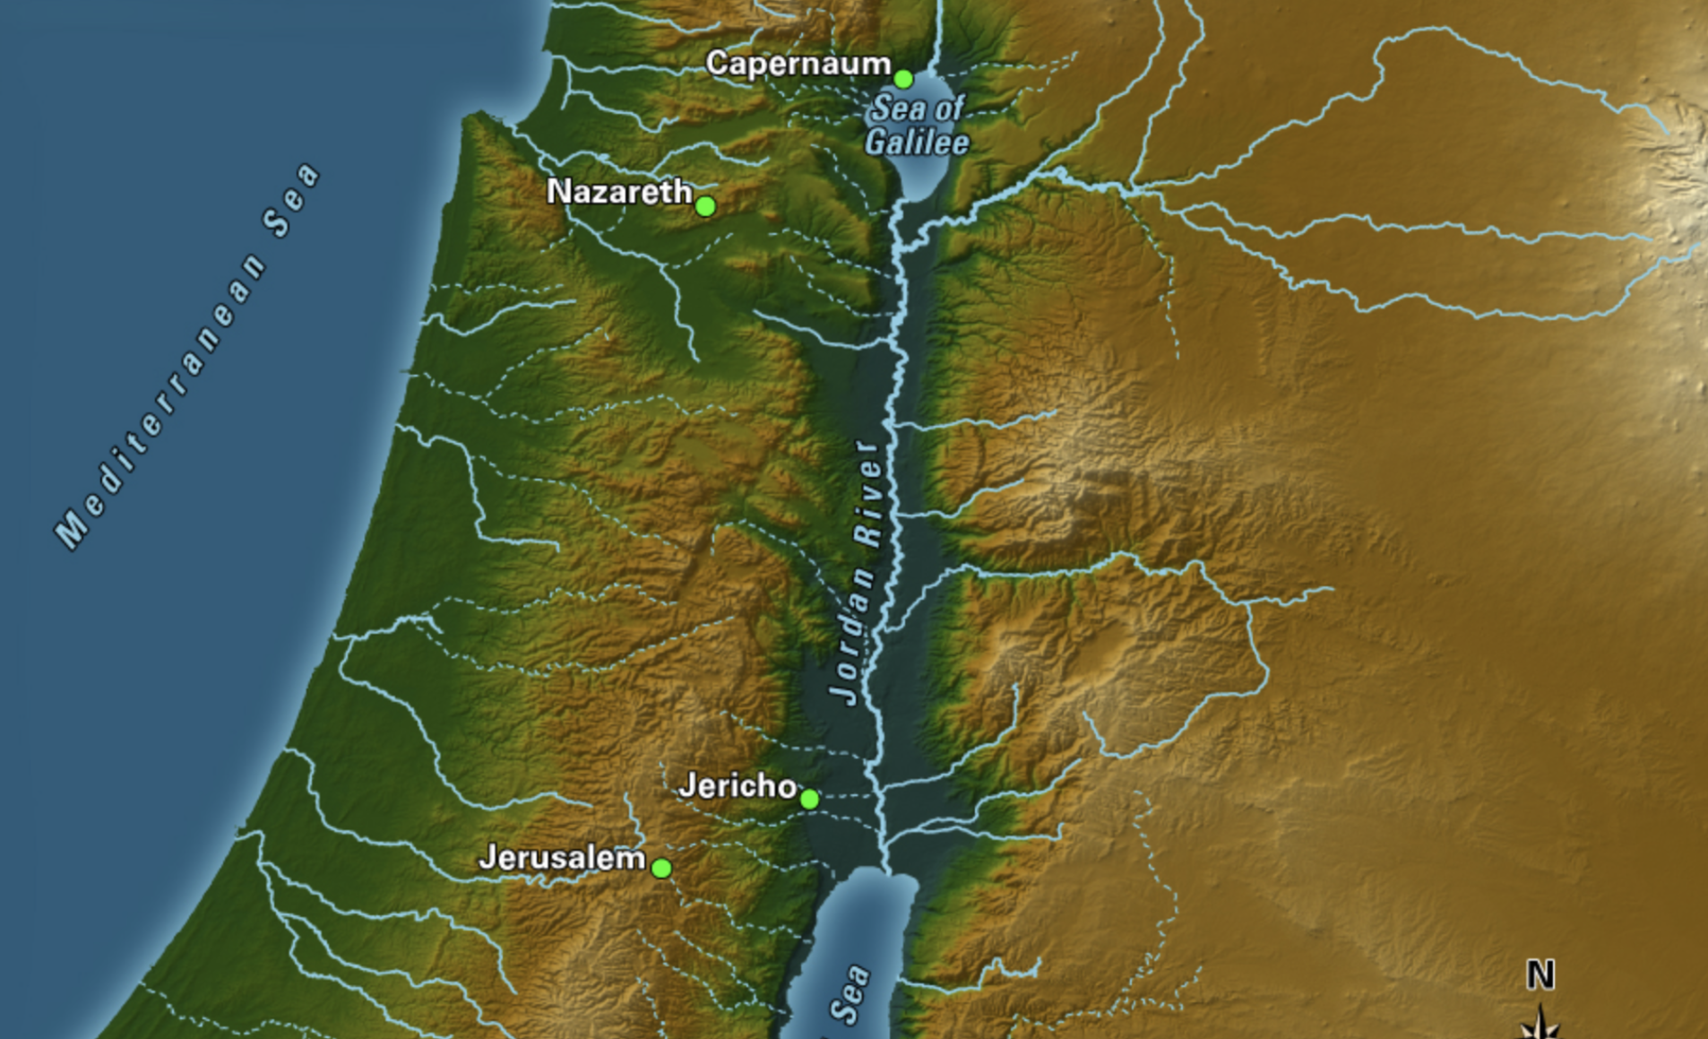
Sea of Galilee vs. The Dead Sea
Notes:
Sea of Galilee is teeming with life. Where Jesus found the fishermen that joined His ministry.
The dead sea has nothing living in it. It is called an endorheic basin. It has inflow only and no outflow. 1400 feet below sea level. Lowest large body of water on the planet. Water goes in but it does not outflow anywhere. It just evaporates and it is very salty because of this.
Men of the word: c> Isaiah 50:4- God feeds me through His word so I can minister to men “Sustain the weary one with a word”. The word I use is God’s word. I must take it in so that I can give it away.
Many Christians take it in, but they don’t give it away.
Go to next slide.

Slide 7


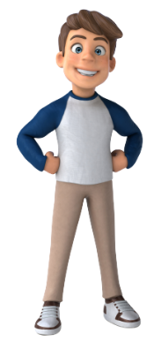
christian
discipler
DEAD SEA
Sea of galileE
x
x
TIMOTHY
Notes:
We need to be taking the word of God and giving it away in order to live a healthy Christian life.
The Christian on the left is unhealthy like the Dead Sea.
The Christian on the right is healthy like the Sea of Galilea.
The Sea of Galilee Christian takes in the word of God and gives it away.

Slide 8


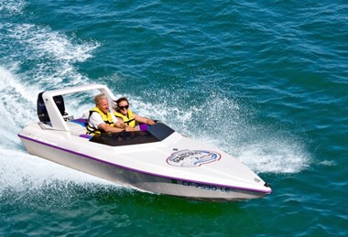
Types of Meetings: The Uniqueness of Discipleship
Cruise Ship = Large Church
Aircraft Carrier = Large Church
Yacht = Small Group
Speedboat = Discipleship
Notes:
I compare a Cruise Ship to a large Church.
Positives: Both can accommodate a large number of people.
Both are impressive and can attract attention.
Lots of things to do and get involved in. There is something for everyone.
Negatives: Tough to maneuver. You have to chart a course and stay on it.
Very expensive to run them. You need bodies in order to keep it going.
Both take lots of training to operate.
Illustration: Cannot go to the captain and say let’s go to Belize instead of Cozumel
Cannot tell the pastor can we look at this passage in John instead of Acts
You have to choose their programs on the boat. You don’t create your own.
Ministry at the large church is only through their programs.
Yacht to a Small Group:
Positives: Can accommodate a few several people. Including couples.
Can cater to the group deciding what they want to do.
Negatives: Still have to stay on a general agenda and no one person can take it off course.
Still takes planning, training and know how to run.
Speedboat is Discipleship:
Positives: Easy to maneuver. You can go anywhere. Either person can decide where to go.
You can go off topic in Discipleship at anytime. (Guy dealing with an issue is where it takes off!)
Any idiot can learn to drive a speed boat very quickly.
So also anyone can disciple
Confidentiality with issues.
Like personal tutor. You can customize your meetings to the person.
Negatives: Not impressive and noticed like the other two. Under the radar ministry.
Bottom Line is we can all get involved in speed boat ministry! We don’t need formal training to do it.

Slide 9
Ezra 7:10
“For Ezra had set his heart to study the law of the Lord and to practice it, and to teach His statutes and ordinances in Israel.”
Notes:
Men:
If you can read your Bible and do what it says you can disciple another man. This is the only prerequisite. We have to study, practice and teach. Don’t get to hung up on study. If you start reading God’s word on your own and applying it you are becoming a man of the word.
As John told us it is no accident you are here. Maybe brought you here this weekend because He wants you to get involved in discipleship.

Slide 10


2 Timothy 2:2
Four Generations
PAUL
TIMOTHY
Faithful Men
Others
Notes:
Read 2 Timothy 2:2
you (timothy 2nd generation) have heard from me (Paul 1st generation) entrust these to faithful men (3rd generation) who will teach others also (4th generation)
Dawson Trotman taught that if you can go to the fourth generation in discipleship it will go on after you are gone.
Once it takes root it can have an amazing impact on our world.
Jesus started with 12 men and changed the world.

Slide 11
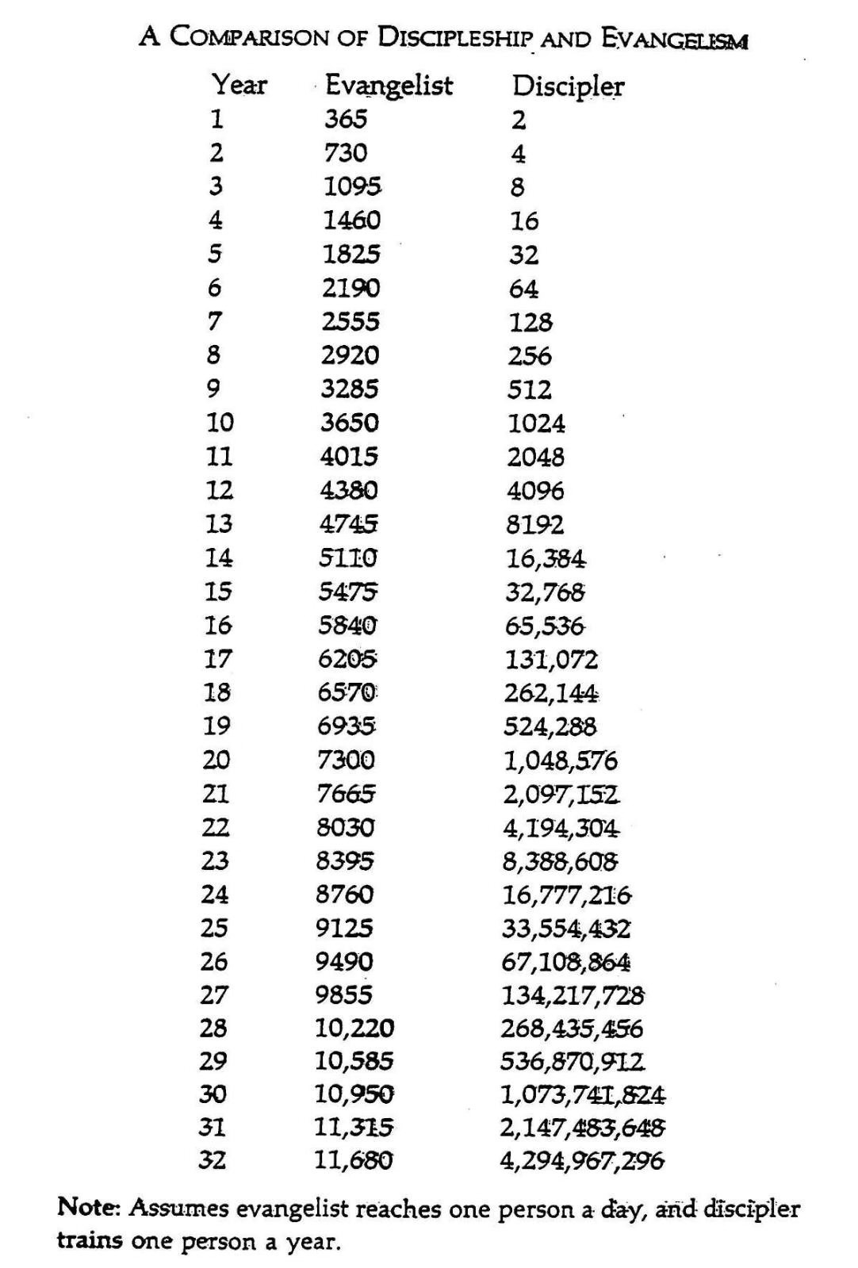
Multiplication Vs. Addition
Notes:
If we can train people to reproduce themselves the impact starts slower but is much greater!

Slide 12
Getting Started
Meet where there are few distractions.
Two Rules
He can quit anytime and so can I.
What we discuss if confidential.
Meet once a week for 1 to 1.5 hours.
Do your best to accommodate his schedule.
Make your appointment for next time before you end.
Be okay with going off topic if he is dealing with stuff or has questions.
Notes:
Meeting where there are few distractions: I try to avoid restaurants. I have had guys that prefer it so I will do it but I try to avoid them.
If he knows he can quit it frees him up to try it out.
He needs to know it is a confidential, safe environment.
Try to meet once a week for consistency. A guy might push it to two weeks but I try for once a week.
Not always possible but I try to be flexible with a guy and meet him when he wants, where he wants. It’s okay to suggest if he is flexible.
You will be challenged and grow. Discipleship blesses the guy giving more than the guy receiving. Acts 20:35
Guys appreciate honesty. If you don’t know it don’t worry about it. You can go find it.
You will lose consistency if you don’t do this.
Customized ministry

Slide 13
Tools For Discipleship
Notes:
No matter how long a guy has been a Christian start at book 1. He will learn something. The other thing is then he has the experience to start at book one when he disciples another man.
The leaders guide is a great help when you are just getting starting. It will give you insight to the questions in each chapter.
Once you get a guy through all three books he will have more understanding of the Christian life than 80% of Christians.
There are topics in this book that our churches don’t cover because they are afraid to or they don’t think they are important. Most pastors have not been discipled so they don’t know how to disciple and therefore don’t talk about it. Discipleship in the church is going to a group class. They are great but it is not getting into another man’s life.

Slide 14
Observations and Applications
Why don’t men get involved in Discipleship?
They don’t believe they can do it.
They don’t want to do it.
Pray for one man to disciple. Start with one man.
The ”People Business” is a messy business. Embrace the reality of it.
Life will be “Unbalanced”. Embrace it.
Don’t worry about not having all the answers.
Minister to men on their terms, not yours.
Don’t get sidetracked by ”Secondary Targets”.
Let God’s word do the work.
You need to be discipled before you disciple another man.
Discipleship is for you, not for the guy you are discipling.
Notes:
Men:
If you can read your Bible and do what it says you can disciple another man.
As John told us it is not accident you are here. Maybe it is because God wants you doing this.
“My kingdom is not of this world…” John 18:36
“I will build My church…” Matthew 16:18
Secondary Targets: Focus on changing institutions rather than investing in men. Whether it is your Church or our country it’s a waste to try to change them.
“for the Word of God is living and active….” Hebrews 4:12
Read 1Thes 2:8

